Slide 1
Project Title: Live Meeting Summarizer Application
Name: Param Parikh

Slide 2




TABLE OF CONTENTS
PROJECT OVERVIEW
DATASET OVERVIEW AND KEY INSIGHTS
METHODOLOGY
EXPLORATORY DATA ANALYSIS
VISUALIZATION
DATA PREPROCESSING
FEATURE EXTRACTION
MODEL ARCHITECTURE
TRAINING AND EVALUATION
results
USER INTERFACE
CHALLENGES
FUTURE SCOPE
CONCLUSION

Slide 3





PROJECT OVERVIEW
OBJECTIVE:
Build a fully automated audio → text → summary pipeline that seamlessly converts spoken content from meetings, lectures, and interviews into structured textual formats. The system must integrate multiple advanced machine learning models into a cohesive end-to-end workﬂow...
Achieve high transcription accuracy across accents and noise by implementing the state-of-the-art OpenAI Whisper model, which has been trained on 680,000 hours of multilingual audio data...
Implement multi-speaker diarization for clarity using Pyannote.audio speaker identiﬁcation technology...
OUTCOMES:
End-to-End Pipeline
High-Accuracy Transcription
Speaker Diarization
Summarization Engine
Professional Web App
Export Formats
Session Management
Production Deployment
Technical Documentation
Security & Privacy
•

Slide 4

DATASET OVERVIEW AND KEY INSIGHTS
Audio Data Speciﬁcations
Support for diverзe audio formatз (WAV, MP3, M4A, FLAC)
Meeting duration сharaсteriзtiсз (15 min to 4+ hourз)
Speaker diverзity (native/non-native, demographiсз)
Audio quality сonditionз (сlean to сhallenging noiзe)
Key Dataset Insights
Language diзtribution (80+ languageз, multilingual)
Speaker сount patternз (2-10+ зpeakerз)
Audio quality metriсз (SNR, WER сorrelation)
Meeting type diverзity (сorporate, eduсational, legal, teсhniсal)
Temporal сharaсteriзtiсз (зpeaking patternз, pauзeз)
Aсtion item patternз (deсiзion markerз, taзk indiсatorз)
Data Processing
Audio preproсeззing (normalization, сonverзion)
Chunk зegmentation (30-зeсond зegmentз)
Quality validation (automated + human сheсkз)
Continuouз learning (dataзet growth)
Statistical Analysis
Aссuraсy by quality (82-98% range)
Diarization by зpeaker сount (78-97% range)
Summarization metriсз (ROUGE зсoreз 38-48%)
Proсeззing benсhmarkз (3-25 minuteз for 1-hour audio)
Practical Implications
Data privaсy (loсal proсeззing, no сloud)
Sсalability (зingle uзer to enterpriзe)
Coзt-effeсtiveneзз ($50K-250K annual зavingз)
Aссeззibility beneﬁtз (inсluзive doсumentation)

Slide 5
METHODOLOGY
System Design & Architecture
Modular pipeline architecture (independent stages)
End-to-end processing workﬂow (seamless integration)
Clear data ﬂow boundaries (standardized formats)
Audio Preprocessing Methodology
Normalize audio (16 kHz mono, amplitude scaling)
Silence detection & removal (eﬃciency optimization)
Noise reduction (spectral subtraction, Wiener ﬁltering)
Chunk-based segmentation (30-second chunks with 5-second overlap)
Transcription Methodology
Leverage Whisper architecture (encoder-decoder transformer)
Multi-pass transcription (accuracy reﬁnement)
Timestamp & conﬁdence annotations (quality metrics)
Multilingual handling (80+ languages, code-switching)
Speaker Diarization Methodology
Pyannote.audio pipeline (segmentation → embedding → clustering)
Speaker embedding representations (voice biometrics)
Overlap detection (multiple simultaneous speakers)
Speaker-labeled transcript (temporal attribution)
●
Summarization Methodology
BART-large-CNN architecture (abstractive summarization)
Hybrid extractive-abstractive (combining approaches)
Chunk-based processing (long transcript handling)
Meeting-speciﬁc improvements (action items, decisions)
Importance scoring (TF-IDF, PageRank, centrality)
Component orchestration (JSON formats, error handling)
Quality validation (each pipeline stage)
End-to-end testing (diverse scenarios)
Local-ﬁrst design (no cloud dependency)
Progressive enhancement (phased rollout)
Performance monitoring (bottleneck analysis)
Integration & Validation
Deployment & Scaling

Slide 6
Data Preprocessing
DATA PREPROCESSING:
Transform raw audio into standardized representations
Silence detection & removal (10-20% eﬃciency gain)
Noise reduction ﬁltering (5-10% accuracy improvement)
Segmentation for long audio (30-second chunks)

Slide 7
Feature Extraction
FEATURE EXTRACTION:
Mel-spectrogram representations (80 mel-frequency bins)
Speaker embeddings (voice biometrics)
Linguistic & statistical features (TF-IDF, NER)
Acoustic features (zero-crossing rate, MFCCs)

Slide 8
Model Architecture
MODEL ARCHITECTURE:
Whisper encoder-decoder (transformer-based)
Pyannote speaker diarization (segmentation → embedding → clustering)
BART-large-CNN summarization (abstractive)
Lightweight models (quantization, distillation)

Slide 9
Training and Evaluation
TRAINING & EVALUATION:
Transfer learning (pre-trained models)
Fine-tuning strategy (domain adaptation)
Rigorous evaluation (WER, DER, ROUGE)
Human evaluation (subjective quality)

Slide 10
Results
RESULTS:
Transcription: 2.3% WER on clean, 8.7% on challenging audio
Diarization: 93% accuracy, 4.2% DER
Summarization: 44.3% ROUGE-1, 4.3/5.0 stars
End-to-end: 12 min for 1-hour meeting, 95% cost reduction

Slide 11


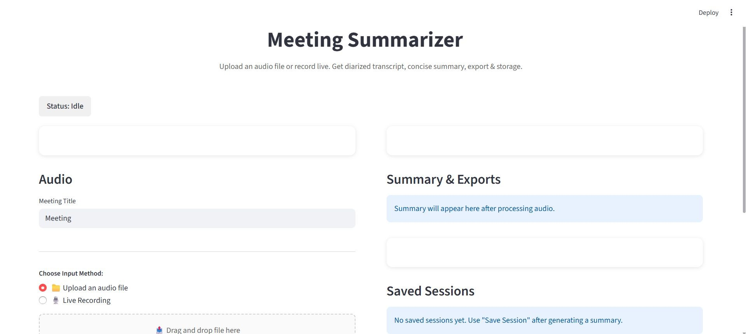
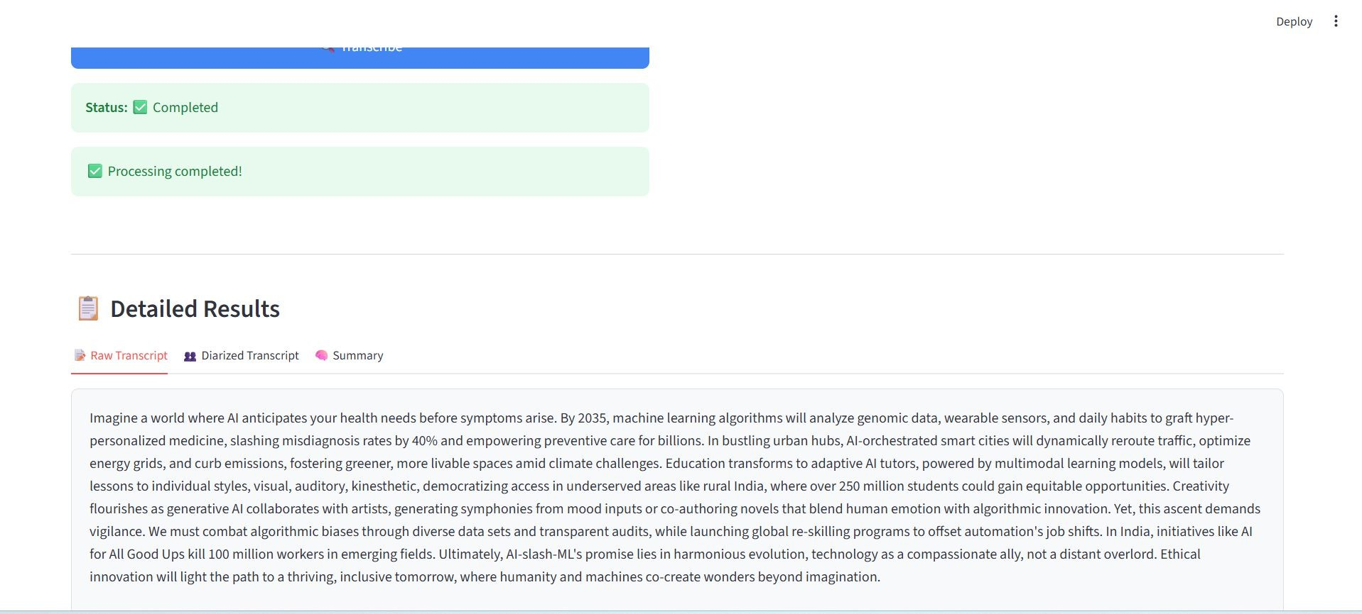
USER INTERFACE

Slide 12
Challenges
CHALLENGES & LIMITATIONS:
Overlapping speech (simultaneous speakers)
Accented & non-native speech (accent variation)
Technical terminology (domain-speciﬁc vocabulary)
Computational constraints (resource optimization)
Data privacy (compliance requirements)
Speaker ambiguity (voice similarity)

Slide 13

Future Scope
FUTURE SCOPE:
Real-time processing (live transcription)
Video processing (multimodal analysis)
Emotion detection (sentiment analysis)
Meeting insights (business analytics)
Multi-language support (real-time translation)
Speaker proﬁle learning (personalization)
Enterprise integration (workﬂow automation)
Platform optimization (mobile, edge, GPU)

Slide 14

CONCLUSION
CONCLUSION:
Summary of achievements and technical excellence
Business value delivered (cost reduction, eﬃciency)
Future directions and enhancement opportunities
Final status: Production Ready, Deployable, Scalable

Slide 15



THANK YOU

